Slide 1
Exploratory Data Analysis
Hospital Data

Slide 2
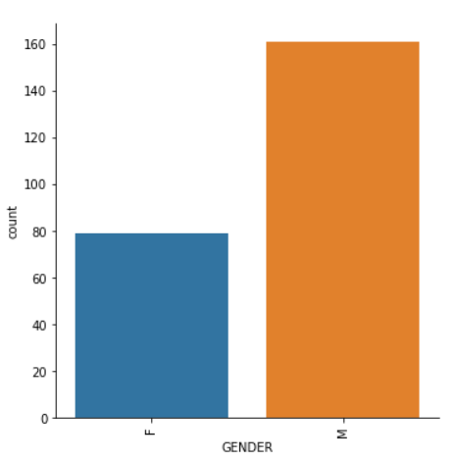
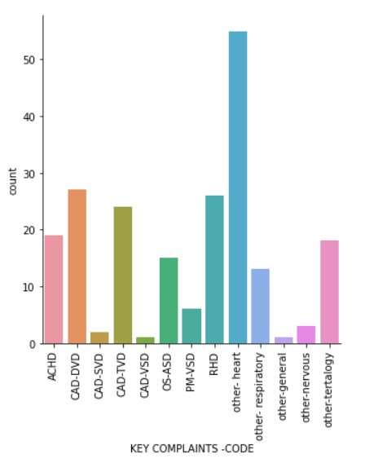
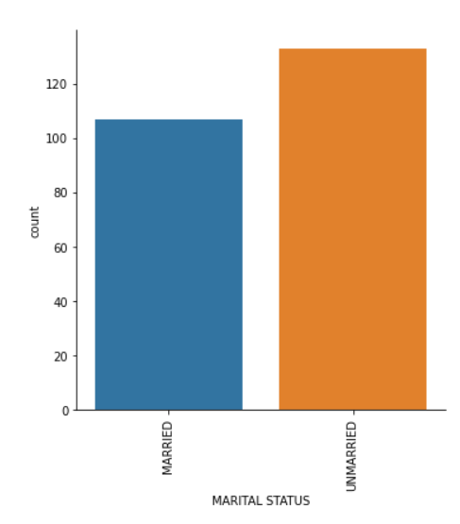
1. Majority of patient admitted is female 2. Majority of patient admitted are Single 3. Most of the patient admitted are associated with Key-Complaint code as Heart

Slide 3
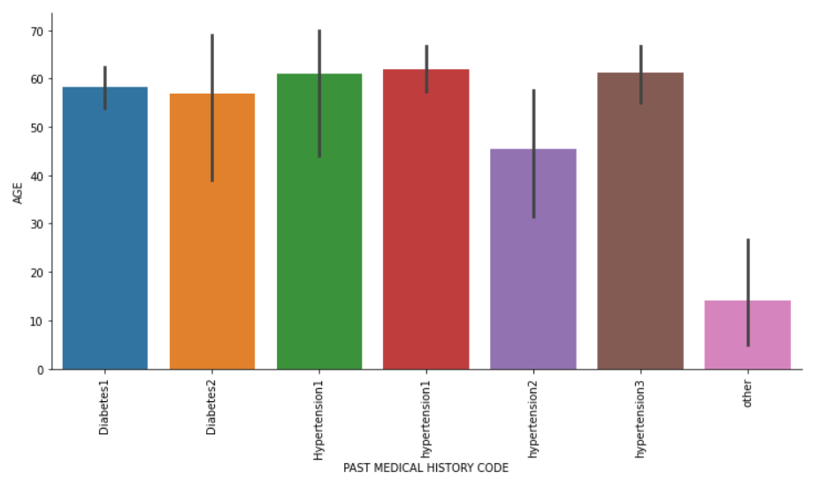
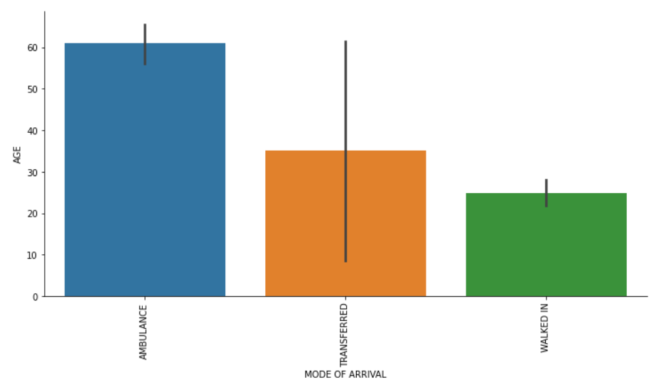
4. Higher the age of the patient, the patient seems to have Hpyertension1 5. Higher the age of the patient, the mode of arrival is via Ambulance

Slide 4
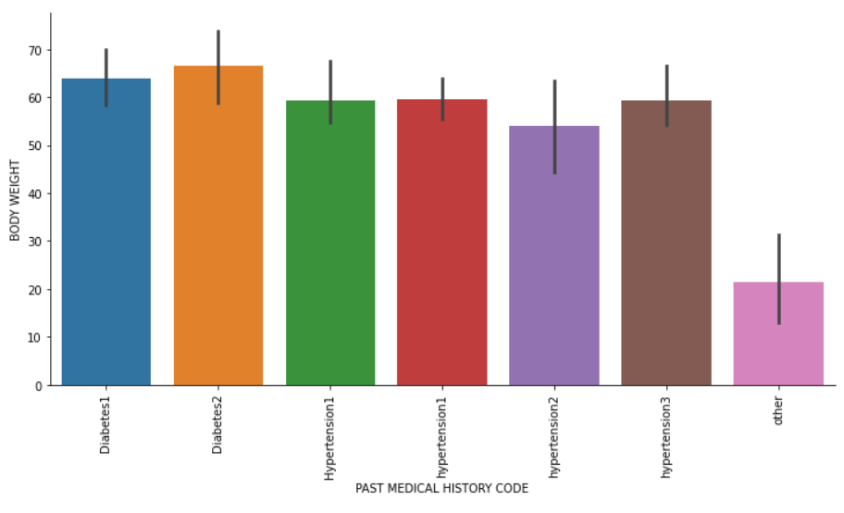
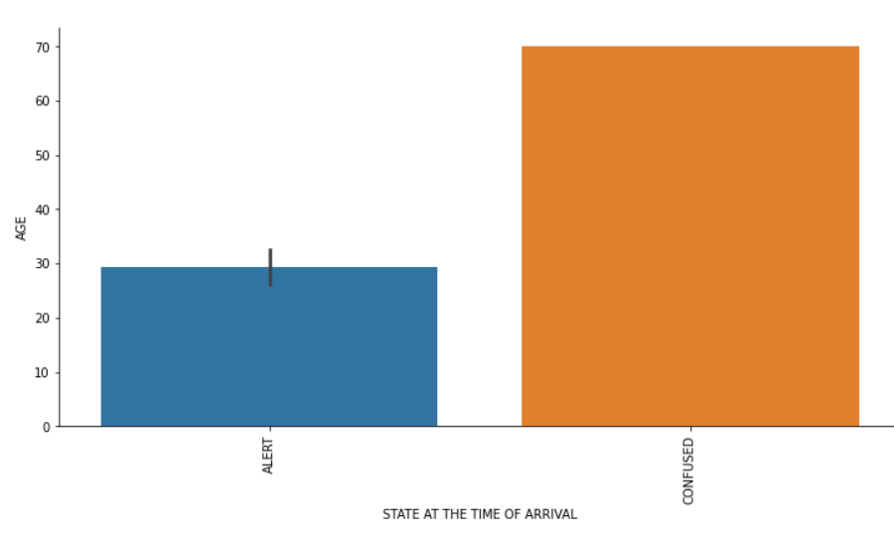
6. Higher the age of the patient, the patient seems to be at confused state when arriving to the hospital 7. Patient with high body weight seems to have past medical record of Diabetics 1

Slide 5
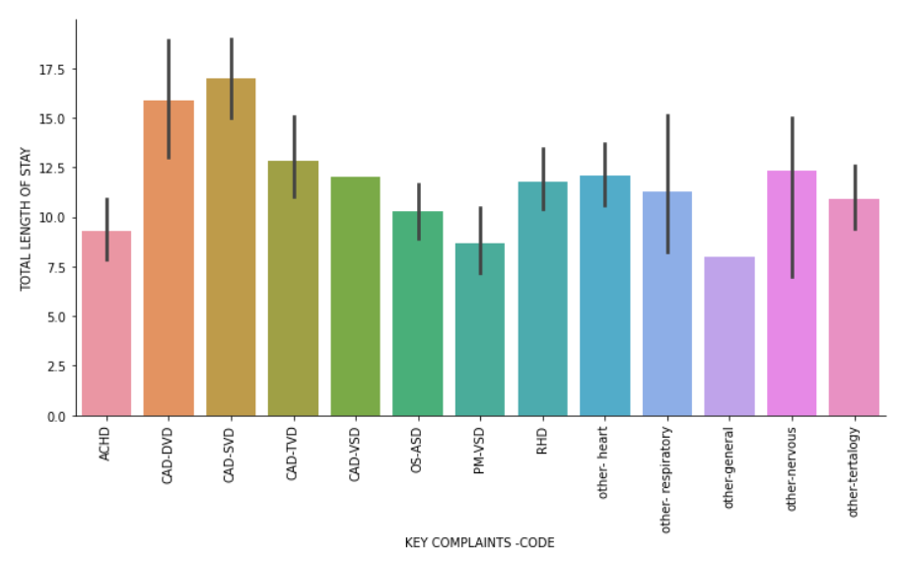
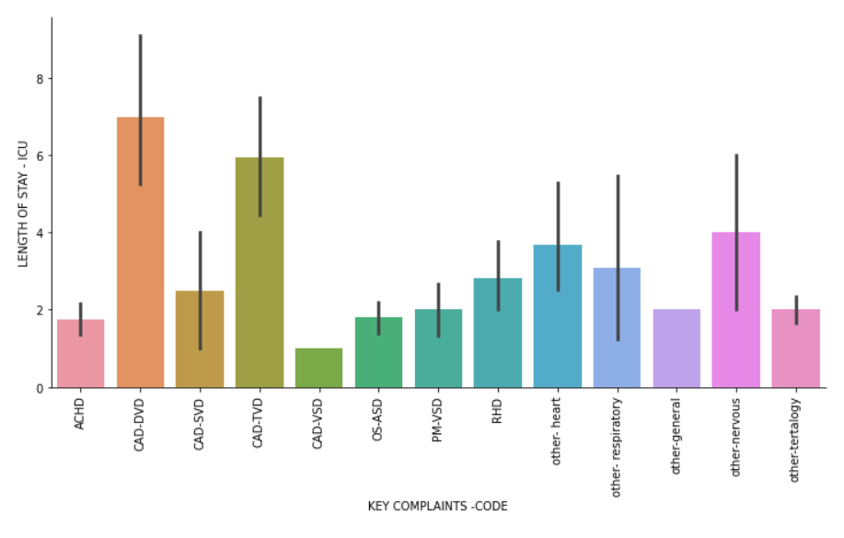
8. Patients with complaint code of CAD-SVD tend to stay longer time in the hospital 9. Patients retained in the ICU for longer time seems to be associated with complaint code of CAD-DVD and TVD

Slide 6
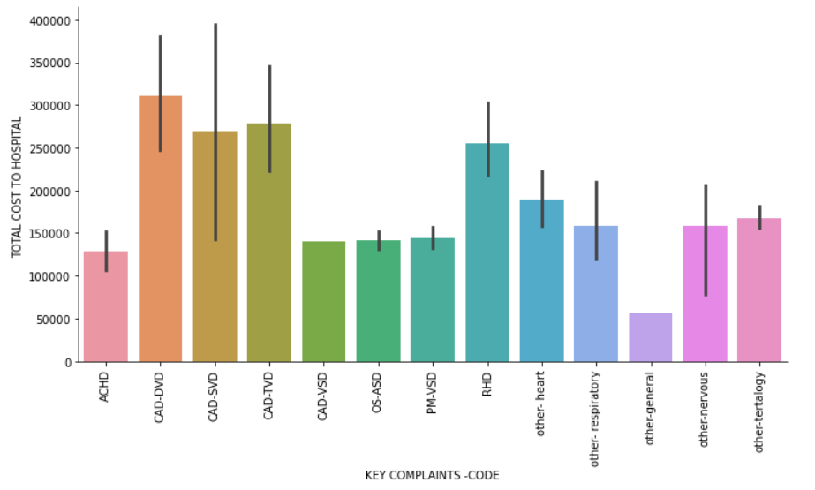
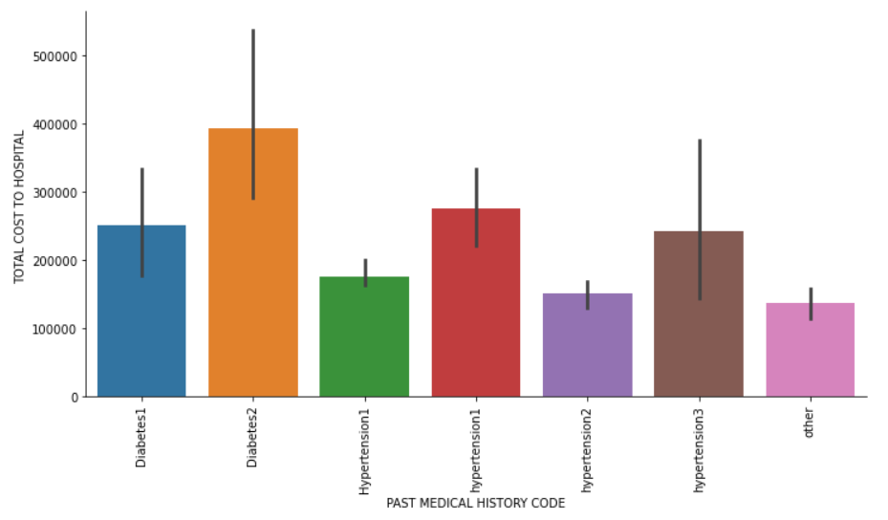
Total Cost to hospital 1. Patients with CAD-DVD are tend to incur most cost to the hospital 2. Patients tagged to Diabetics 2 seems to contribute more to hospital cost

Slide 7
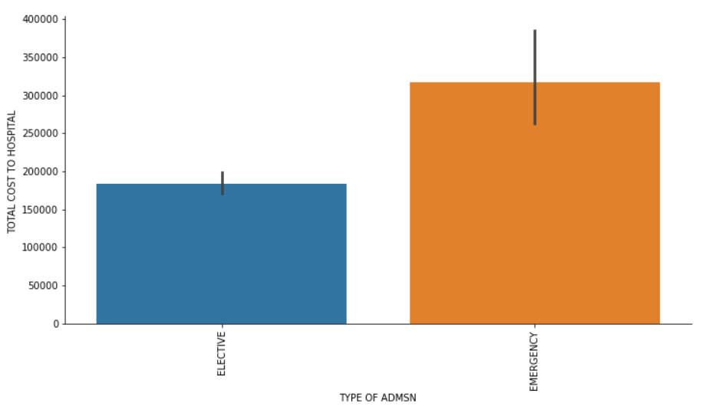
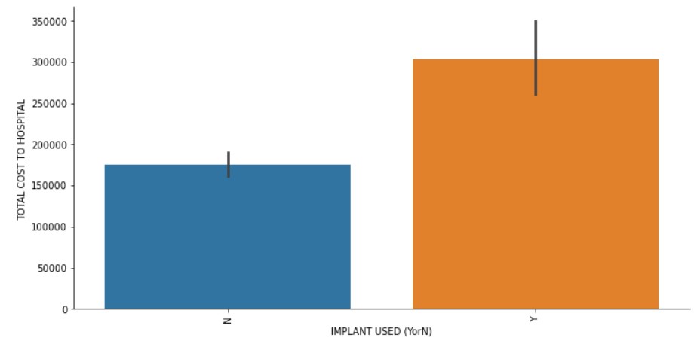
Total Cost to hospital 3. Patient admitted as emergency are contributing to higher cost 4. Implant contributes more to the cost

Slide 8
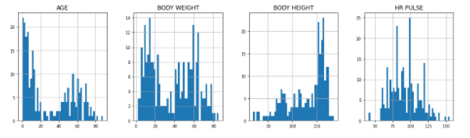
Distribution of All numeric inputs

Slide 9
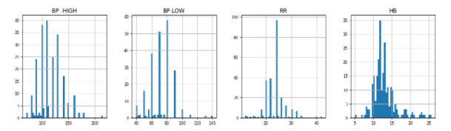
Distribution of All numeric inputs Continued…

Slide 10
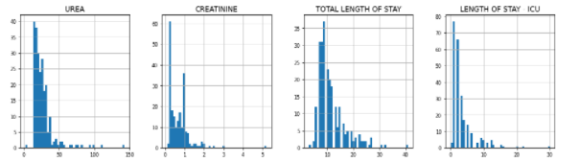
Distribution of All numeric inputs Continued…

Slide 11
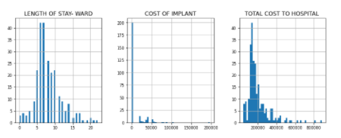
Distribution of All numeric inputs Continued…

Slide 12
Pre-Processing Steps
1. Scaled the data with Standar Scalar
2. Imputed the NAN with mode for categorical columns and median for number columns
3. Retained the past medical history record since the data size is considerably small

Slide 13
Modelling
0.92
0.92
1. Started with Linear Regression which gave a Train score of 0.92 and Test score of 0.66.
2. Decision Tree provided with train score of 1 but a test score of 0.42 (Over-fitted issue)
3. Random forest without any tunning resulted in train score of 0.95 and test score of 0.81
4. Adaptive boosting resulted in train score of 0.98 and test score of 0.81
5. XG boost didn’t give increased the score much (train score = 0.99 but test score of 0.76)

Slide 14
Modelling Contd..
6. Used Voting Method to stabilize the results (Train Score = 0.99, Test Score = 0.80)
7. LARS regression gave the best result with train score of 0.870 and test score of 0.875
8. Made a stacking of XGBOOST, ADABOOST, Random-Forest, LARS which resulted in Train score of 0.99 and test score of 0.80
Conclusion: We could go with LARS regression which gave the best score with least errors

